Slide 1
GPU accelerated application tracing
David Couturier
B. Eng.
Updated in May 2015

Slide 2
Content
Page 03 / Context
Page 10 / Objectives
Page 12 / Solution
Page 19 / Methodology
Page 22 / Results
Page 26 / Use Cases
Page 30 / Future Work

Slide 3
Context: Heterogeneous Hardware
CPU
GPU
1 to 8 physical cores
High frequency (< ~ 4 GHz)
Up to 3072 computation cores
Moderated frequency (< ~ 1.2 GHz)
Parallel computations (SIMD)
1000s of GFLOPS
100s of GFLOPS
Serial computation
http://www.iconarchive.com/show/electronics-icons-by-double-j-design/CPU-icon.html : (https://creativecommons.org/licenses/by/4.0/)
http://www.iconarchive.com/show/bagg-and-boxs-icons-by-babasse/carte-graphique-icon.html : (http://creativecommons.org/licenses/by-nc-nd/4.0/)

Slide 4
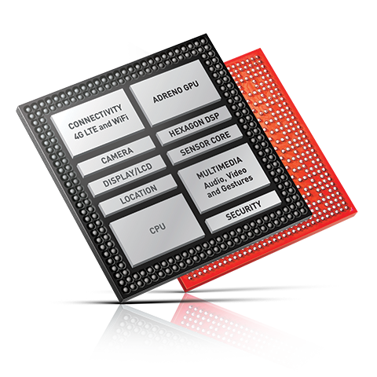
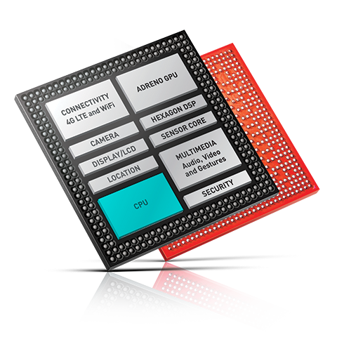
Context: Heterogeneous Hardware
NVIDIA : Tegra
Intel : Intel HD Graphics
Qualcomm : Snapdragon
AMD : « APU » (Accelerated processing unit)
Zynq (CPU + FPGA)
XeonPhi
Snapdragon 810 (Qualcomm )
Source: qualcomm.com

Slide 5
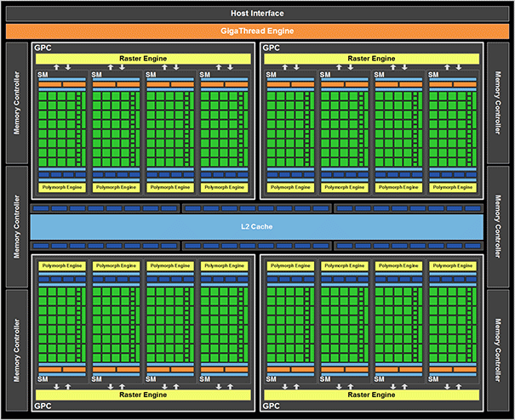
Context: Architecture
Source: nvidia.com
Notes:
Source: Nvidia/GeForce

Slide 6
Context: OpenCL
User Space
OpenCL Application
OpenCL
Kernel Space
Linux Kernel
Drivers (Graphic, Audio, …)
Hardware Layer
CPU
Sound card
GPU
…

Slide 7
Context: TRACING
Trace CPU
Trace GPU

Slide 8
Context: CPU Trace of Opencl application
Trace Compass:

Slide 9
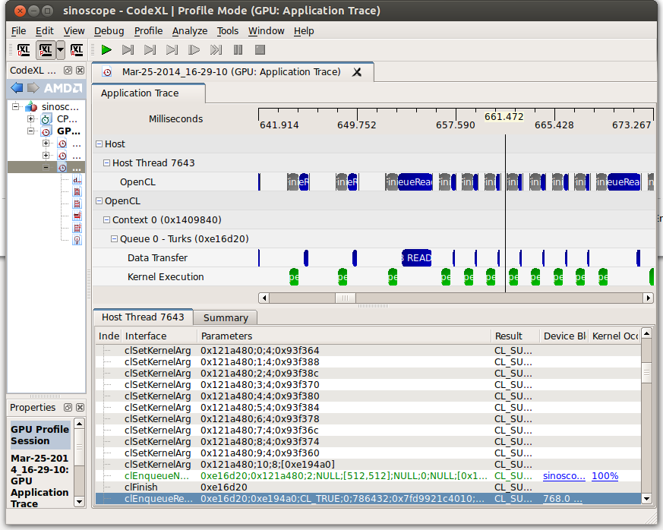
Context: GPU Trace
CodeXL (AMD’s GPU tracing tool)
Limitations:
OpenCL application has to be launched by CodeXL
Recording trace performance for large traces
AMD GPU only

Slide 10
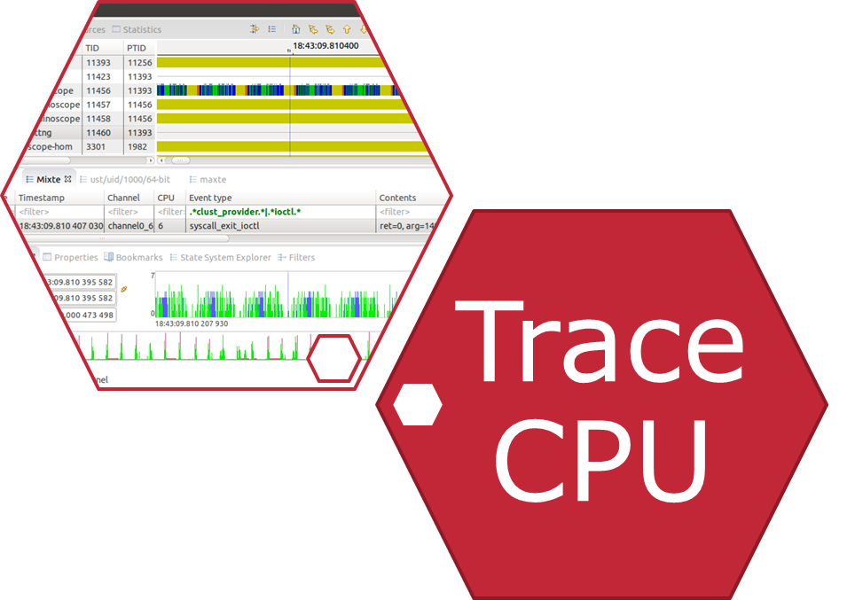
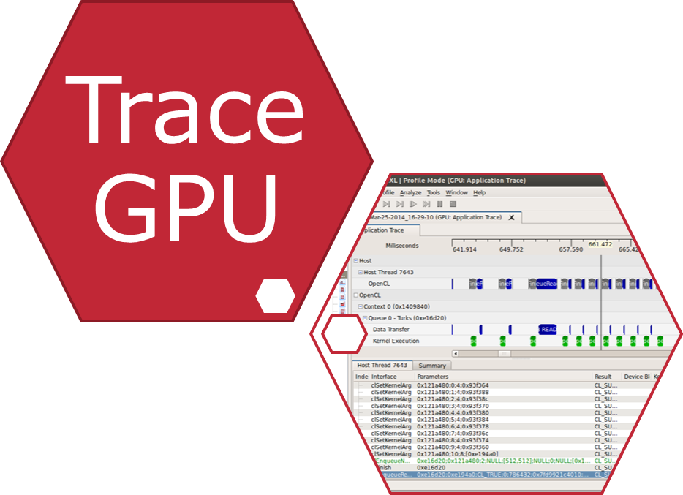
Objective: Unified trace
Unified Trace

Slide 11
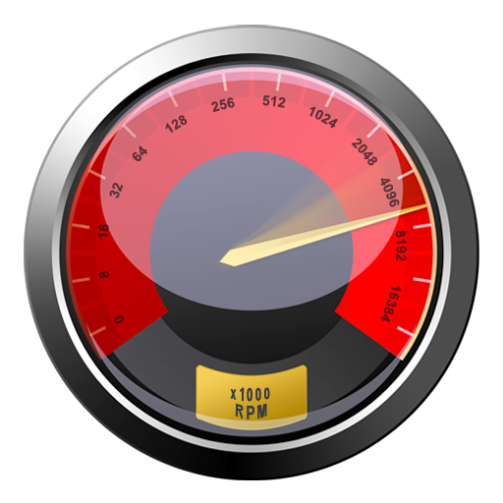
Secondary Objectives
Performance
Minimal overhead on the system
Problem solving

Slide 12
Solution: Opencl profiling
clGetEventProfilingInfo
Task’s enqueued time
Task’s submission time
Task’s start time
Task’s end time

Slide 13
Solution: Non monotonic profiling

Slide 14
Solution: Host-Device synchronization

Slide 15
Solution: Dynamic symbol overloading
User Space
OpenCL Application
CLUST
OpenCL
Kernel Space
Linux Kernel
Drivers (Graphic, Audio, …)
Hardware Layer
CPU
Sound card
GPU
…

Slide 16
Solution: Synchronous API call

Slide 17
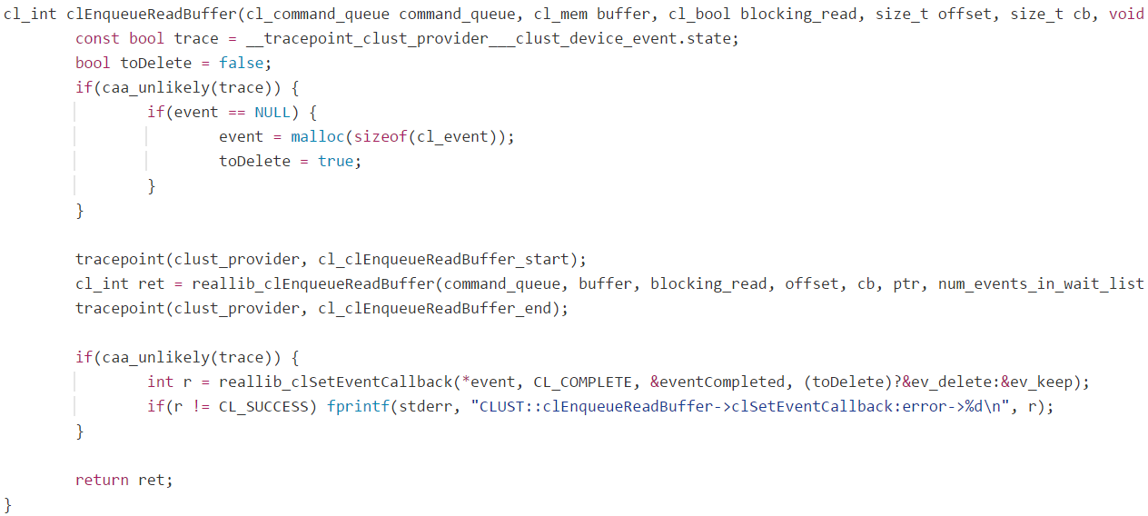
Solution: asynchronous API call

Slide 18
Solution: Asynchronous API call & Callback function

Slide 19
Methodology Configuration
Intel i7-4770 with HD Graphics 4600 integrated graphics
32 GB DDR3 RAM
Ubuntu 14.04 (Kernel 3.18.4 + patch)
Beignet v1.0.2 OpenCL drivers + patch
LTTng v2.6.0-rc1
Monotonic clock
1000s of iterations measured many times to acquire statistics

Slide 20
Methodology Measuring synchronous function overhead

Slide 21
Methodology Measuring asynchronous function overhead

Slide 22
Results: CLUST Overhead synchronous functions
Qty. (iterations) | Reference (ns) | Preload (ns) | UST Tracing (ns) | Preload Overhead (ns) | UST Tracing Overhead (ns)
10⁰ | 16 | 18 | 383 | 2 | 367
10¹ | 5.2 | 7.8 | 366.5 | 2.6 | 361.3
10² | 4.64 | 6.66 | 365.68 | 2.02 | 361.04
10³ | 4.291 | 6.058 | 365.168 | 1.767 | 360.877
10⁴ | 4.277 | 6.283 | 359.780 | 2.006 | 355.503
10⁵ | 4.526 | 6.484 | 359.379 | 1.958 | 354.853
10⁶ | 4.531 | 6.467 | 363.313 | 1.936 | 358.782
10⁷ | 4.537 | 6.499 | 361.145 | 1.962 | 356.608
10⁸ | 4.535 | 6.460 | 361.108 | 1.925 | 356.573
→ ~ 1 ns overhead per inactive UST tracepoint → ~ 180 ns overhead per active UST tracepoint

Slide 23
Results: CLUST Overhead asynchronous functions
Buffer size (byte) | Reference (ns) | Preload (ns) | UST Tracing (ns) | Preload Overhead (ns) | Tracing overhead (ns)
4x10⁰ | 149.51 | 164.7 | 7000.6 | 15.2 | 6851.1
4x10¹ | 158.99 | 168.7 | 7026.8 | 9.7 | 6867.8
4x10² | 156.15 | 174.7 | 7269.3 | 18.5 | 7113.2
4x10³ | 188.44 | 226.7 | 7043.6 | 38.3 | 6855.2
4x10⁴ | 1499.76 | 1503.3 | 8393.0 | 3.6 | 6893.3
4x10⁵ | 17805.67 | 17862.1 | 25404.7 | 56.4 | 7599.0
→ [3.6, 56.4] ns overhead per « preloaded » asynchronous call* → ~ 7030 ns overhead per traced asynchronous call

Slide 24
Results: CLUST Overhead Real Opencl application
Buffer width (pixels) | Buffer height (pixels) | Reference (ns) | Preload (ns) | UST Tracing (ns) | UST + Kernel Tracing (ns)
1 | 1 | 35198 | 36399 | 50890 | 58838
10 | 1 | 35183 | 35702 | 51883 | 58265
10 | 10 | 36031 | 36890 | 50758 | 59619
10 | 100 | 37937 | 39067 | 55820 | 61108
100 | 100 | 56770 | 59709 | 75073 | 84746
1000 | 100 | 250694 | 251165 | 268726 | 280299
1280 | 720 | 1951826 | 1951965 | 1976916 | 1988445
1920 | 1080 | 4466096 | 4466777 | 4491589 | 4511394
Notes:
14 appels synchrones par itération
2 appels asynchrones par itération → 14 x 360 ns + 2 x 7030 ns = 19 100 ns

Slide 25
Results: CLUST Overhead Real Opencl application (…)
Buffer width (pixels) | Buffer height (pixels) | Preload Oerhead (%) | UST Tracing Overhead (%) | UST + Kernel Tracing Overhead (%)
1 | 1 | 3.41% | 44.58% | 67.16%
10 | 1 | 1.48% | 47.47% | 65.61%
10 | 10 | 2.38% | 40.87% | 65.47%
10 | 100 | 2.98% | 47.14% | 61.08%
100 | 100 | 5.18% | 32.24% | 49.28%
1000 | 100 | 0.19% | 7.19% | 11.81%
1280 | 720 | 0.01% | 1.29% | 1.88%
1920 | 1080 | 0.02% | 0.57% | 1.01%

Slide 26
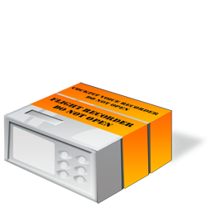
Use cases
System-wide unified tracing
Flight recording mode
24/7 volatile recording
Hard drive dump when required
OpenCL application optimization
OpenCL application debugging

Slide 27
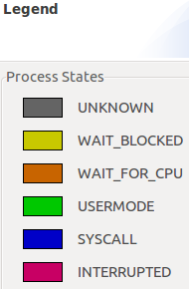
Use case: Ressource sharing

Slide 28
Use case: CPU Preemption

Slide 29
Use case: Opencl pipeline usage maximisation
Notes:
Chevauchement de transferts de données et d’exécution de noyau openCL

Slide 30
Future work
Trace analysis utilities
Hardware performance counter data acquisition
OpenCL 2.0 support
OpenGL tracing
Vulkan API
Heterogeneous computing framework
CPU-GPU
CPU-DSP
…
Notes:
Chevauchement de transferts de données et d’exécution de noyau openCL

Slide 31
Questions?

Slide 32
Thank you!

